Slide 1
Research Method

Slide 2

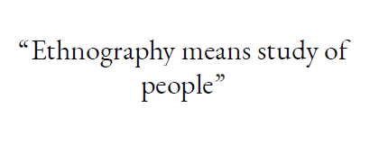
Ethnography

Slide 3
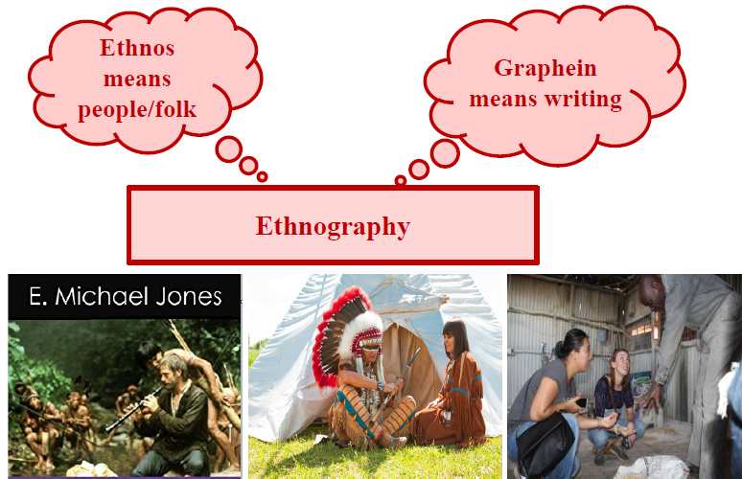
Ethnography

Slide 4
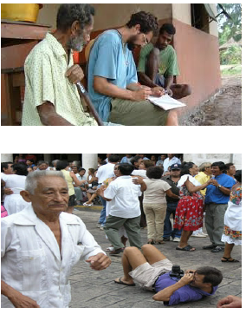
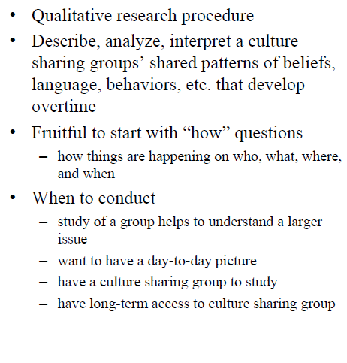
Ethnography

Slide 5
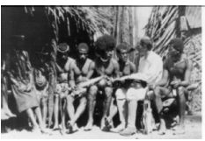
Ethnography: Characteristics
Contextual
Research is conducted in the context in which the subject is normally live and work
Unobtrusive
Research avoids manipulating the phenomenon under investigation
Longitudinal
Tends to run for longer period
Collaborative
Involves the participation of the stakeholders other than researchers
Interpretive
Researchers carries out interpretive analysis of the data

Slide 6
How Is It Done?
The research starts with initial concepts, system components, behaviors, fact-based questions.
Next, decide on the entry point in the fieldwork, i.e., search and collaborate with informant.
Collect data through several session using different methods, such as
observations,
interviews,
documents,
artifacts
Types of data
data supplied by participant
ethnographers’ interpretation of the participants data
collective information
Analysis of data
to develop themes, descriptions, interpretation
collected data will help us to understand the larger issue among the group.
the data will delineate the day-to-day picture of the people, their behaviors, shared ideals and values within the group.
the data is shaped up by the culture, ideals and values of the researchers.
Owing to budget constraints it may be difficult for the researcher to find everything at one point, hence, multi-sited ethnography is touted as a best option

Slide 7
Ethnography
Pros
Ethnography research allows to have an in-depth understanding of the shared culture, behavior, ideals, and values of a group.
Since observation and interviews are open-ended, this research method can easily evolved and discover new interesting things about the group.
Cons
Time consuming and costly research approach.
Researcher may end up having a lot of data to conduct analysis.
It depends on the researcher’s relationship with the subject and shaped up by the cultural bias.
It also depends on the openness and honesty of the subject.

Slide 8
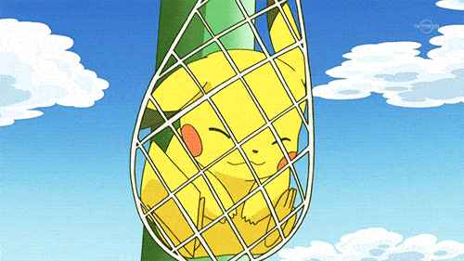


Slide 9


Slide 10


Slide 11
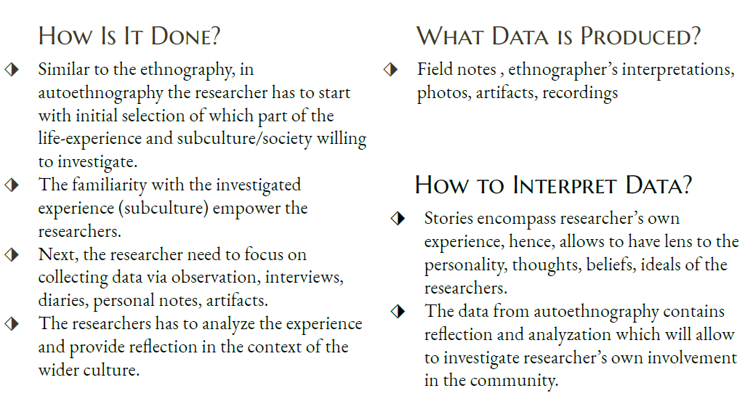

Slide 12
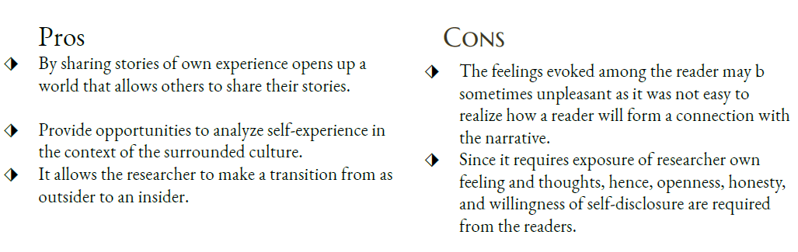

Slide 13


Slide 14
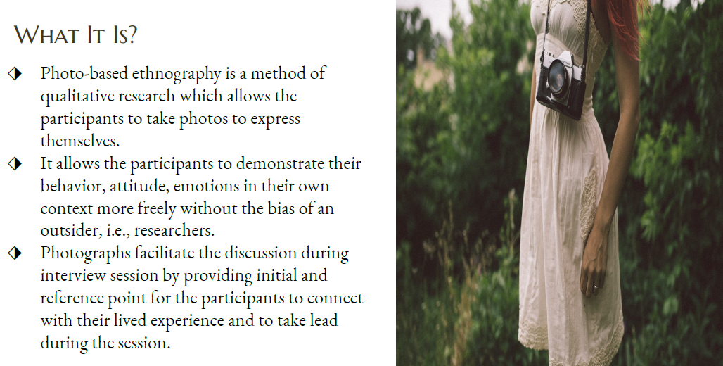

Slide 15
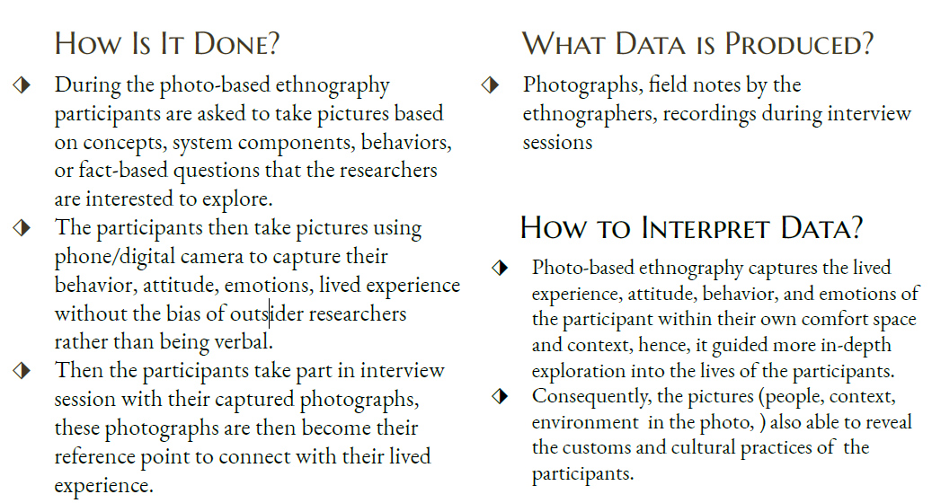

Slide 16
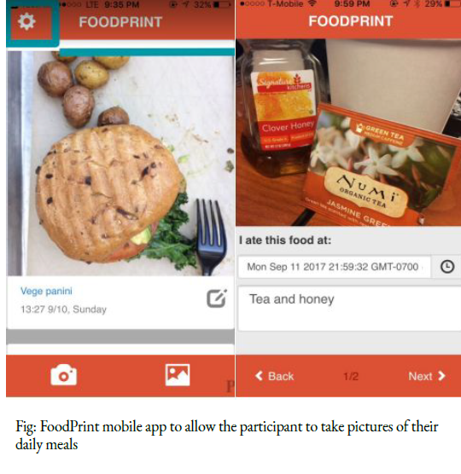

Slide 17
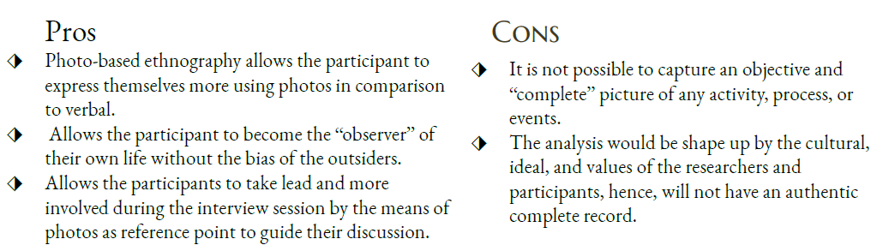

Slide 18
In-class Activity

Slide 19
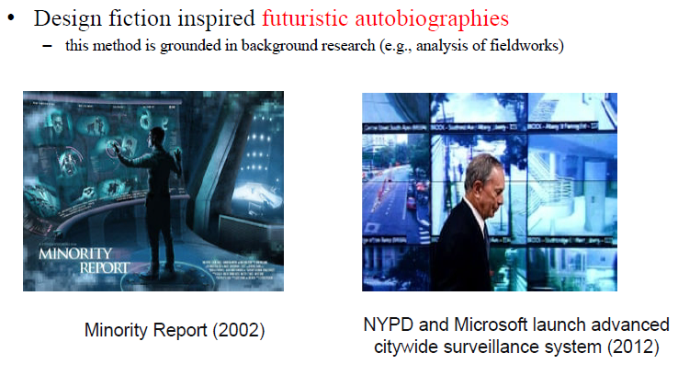
In-class activity

Slide 20

In-class activity
We have created three stories
Each story contains a questions
Complete the stories answering the questions

Slide 21
In-class activity: Story 1
It is 2035. You have designed a telepresence system which is a holograph enables transfer of visual, auditory, olfactory, and haptic information. Your system enables older adults to visit their family members throughout the day. Owing to huge potential of such system Microsoft’s “Future Older Adults” lab wants to purchase your system and to donate the system to four different organizations/country/ people of your choice. The users will use your system as they wish. Now, do you want to add any extra features/functions to your system? Where would you want to donate your system? Why did you chose these recipients?

Slide 22
In-class activity: Story 2
It is 3.00 am, March 2040. You are writing your daily log
of your research. Today you worked on developing a neural
schema for a system that is designed to monitor medication
of older adults in a hospital. You are developing the neural
schema so that it would point out side effects of medication
experienced by the older adults based on how the older
adults feels and their vital signs. While testing your neural
schema in the lab, the outcome produced by it made you
feel a shiver down your spine. What phenomena will give
you such a feeling and what will you write in your log
about that incident?

Slide 23
In-class activity: Story 3
Recently (2037), your designed automated walker is made available to the market for potential users. Your automated walker is able to help older adults to get out of bed, to go to bathroom, go up from chair. Besides, walker has the capabilities to encourage older adults to walk independently
based on how safe the surroundings are and how are the physical conditions of the older adults. Such a way you aim to improve older adults overreliance on the technology and encourage to maintain/remain active with minimal risk. Consequently, your design is very compact to fit into small spaces and also safe to use in the shower/bathroom. Unfortunately, some bad incidents/accidents were reported by the user of your walker. What do you think the reasons behind such incidents? How you will response to deal with
such incidents?

